Slide 1
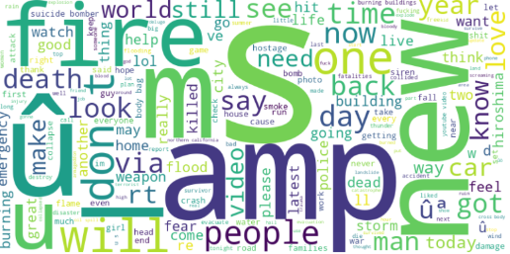
Natural Language Processing with Disaster Tweets
Harshal Amin

Slide 2
AI for Crisis: Can NLP Save Lives?
The Challenge: Identifying Real vs. Fake Disaster Tweets
Social media is the first source of disaster updates, but not all tweets are accurate. False alarms create panic, while ignoring real warnings can be catastrophic. How do we filter real disaster tweets from noise?
Emergency Responders can prioritize real disaster reports. News Agencies can avoid spreading misinformation. Government Agencies & NGOs can improve disaster relief coordination. https://link.springer.com/article/10.1007/s13278-024-01308-8?
Dataset: 10,000 tweets, manually labeled as: 🚨 Real Disasters (e.g., "Massive earthquake hits Japan. 7.5 magnitude.")
🚫 Not a Disaster (e.g., "My phone battery died… total disaster! 😩")
Additional Columns: id, keyword and location
Tweets are short, informal, and sometimes sarcastic, making classification challenging.
Notes:
Communication during emergencies using television and radio has the disadvantage of one-way communication from the source of information to the recipient. Social media doesn’t. For example, people may use Twitter to communicate with their loved ones in the disaster area to ensure they are safe and secure. They share information about food, water, and other needs They also share information about infrastructure damages and problems

Slide 3
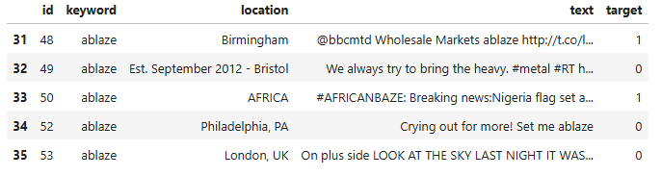
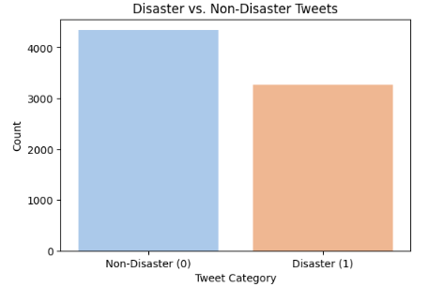
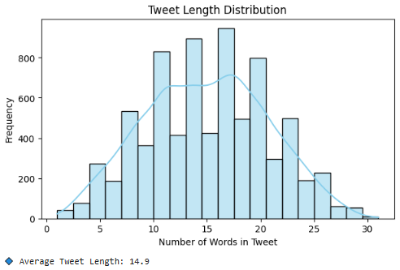
EDA
Notes:
The left graph shows the distribution of disaster vs. non-disaster tweets. The dataset is fairly balanced, but ensuring no bias in the model is crucial. The right graph represents the tweet length distribution, showing that most tweets range between 10 to 20 words, with an average of 13 words. This is important for BERT tokenization, as we can decide an optimal sequence length to prevent unnecessary padding or truncation.

Slide 4
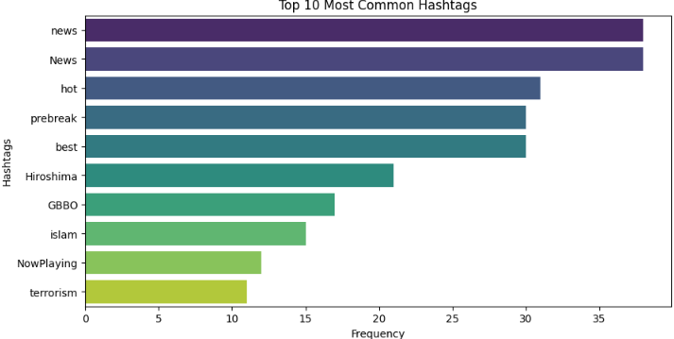
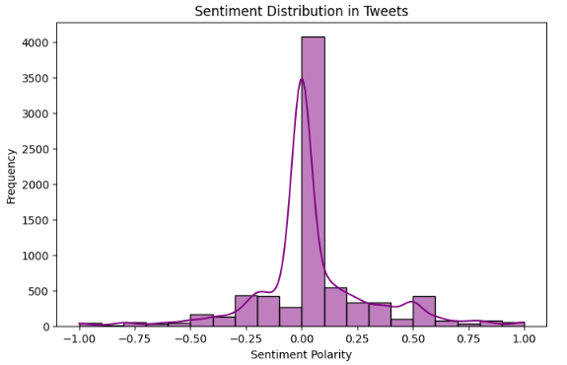
EDA
Notes:
Words like "news", "hot", and "hiroshima" suggest that many tweets relate to current events and disasters. This can be useful for feature engineering if we decide to keep hashtags.The sentiment distribution graph below shows that most tweets center around a neutral sentiment, but there are some with strong positive or negative tones.Sentiment analysis can be an additional feature to help classify whether a tweet is related to a disaster or not.

Slide 5
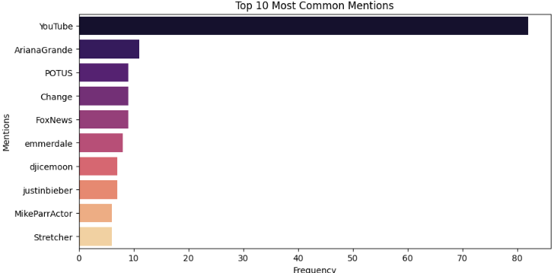
EDA
Notes:
"YouTube" appears the most, likely due to news or viral videos related to disasters.Other mentions, like "ArianaGrande" and "change", suggest that some tweets relate to public figures or activism.While mentions may not always indicate disasters directly, they provide context and can influence model decisions. Instead of removing them, encoding them properly may improve classification.

Slide 6
Why BERT?
Why certain models underperformed.
Regression
Neural Network
BERT
66-68% accuracy – Regression-based models fail to capture semantic meaning, treating words as independent entities.
They struggle with phrases like "not a disaster" vs. "this is a disaster", which require contextual understanding.
While faster to train, they rely heavily on feature engineering (e.g., sentiment scores) and lack generalization for text-heavy tasks.
73% accuracy- Deep NNs capture non-linear word relationships but ignore sequential word order, limiting their ability to understand context.
They require large datasets to generalize well, unlike BERT, which benefits from transfer learning.
Without pre-training, they struggle with sarcasm and unseen phrases, making them less reliable for social media text.
Rank: 200+
BERT (F1: 0.82) significantly outperforms others by leveraging self-attention to capture bidirectional context, crucial for disaster-related tweets with negation and sentiment.
However, it is computationally expensive, requiring longer training times (176s/step) due to token-level processing, making it resource-intensive for large datasets.
Rank: 40s
Notes:
1. 66-68% accuracy. A major disadvantage of these models is their inability to understand semantic meaning. Traditional vectorization methods treat words as independent entities and do not consider word order or relationships between words, which can be crucial in disaster-related tweets where phrases like “not a disaster” and “this is a disaster” carry opposite meanings. Additionally, these models are often more sensitive to feature engineering. Without manually engineered features like sentiment scores, keyword flags, or topic modeling, they may not generalize well to unseen data. While they train faster than deep learning models, their inferior performance on text-heavy tasks makes them less ideal for this dataset, as evident from their lower accuracy. 2. Unlike regression-based models, deep NNs can capture non-linear relationships between words and features, allowing them to recognize complex tweet patterns. However, a limitation of feedforward NNs is that they do not consider sequential word order, treating each input as independent of surrounding words. This can be problematic for textual data, where context and order define meaning. Another challenge with deep NNs is their need for more data. Unlike BERT, which benefits from transfer learning, a deep NN requires large labeled datasets to generalize well. Without pre-training on large-scale corpora, it may struggle with unseen phrases or sarcasm, which are common in social media text like tweets. 3. BERT-based model significantly outperformed all other models, with an F1 score of 0.82 on validation. Unlike regression-based models and feedforward NNs, BERT leverages self-attention mechanisms to understand word context bidirectionally, meaning it considers both previous and next words to interpret meaning. This is crucial for classifying disaster-related tweets, where negation and sentiment play a big role. BERT comes with computational costs. As evident from your training logs, it required longer training times (176s per step) compared to other models. This is because transformers process text at the token level, making them more resource-intensive, especially on large datasets.

Slide 7
Inner Workings of BERT
"I can't believe the flood destroyed everything overnight! #disaster"
1. Tokenization & Subword Splitting- BERT breaks the sentence into smaller subwords: ["i", "can", "'t", "believe", "the", "flood", "destroyed", "everything", "overnight", "!", "#", "disaster"]. This ensures that even rare or unknown words are handled effectively.
2. Adding Special Tokens- BERT inserts [CLS] (classification) at the start and [SEP] (separator) at the end: ["[CLS]", "i", "can", “’t”, "believe", "the", "flood", "destroyed", "everything", "overnight", "!", "#", "disaster", "[SEP]"]
3. Word Embedding & Positional Encoding- Each token is mapped to a high-dimensional vector (word embedding) that represents its meaning. Positional embeddings help BERT understand the order of words in the tweet.
Notes:
Breaking Down the Tweet (Tokenization)
Before understanding the meaning of a sentence, BERT first breaks it into smaller pieces called tokens.
Unlike traditional models that treat each word separately, BERT splits words into subwords to handle rare or unknown words.
For example, the word “overnight” might be split into ["over", "night"], while hashtags like "#disaster" are kept as meaningful tokens.
This ensures BERT can process uncommon words, which is crucial in tweets where new slang and abbreviations are common.
Adding Special Markers for Meaning
BERT doesn’t just read text directly—it adds special tokens that give extra context.
The [CLS] token is added at the beginning of the sentence, telling BERT that this text will be classified (Disaster vs. Not Disaster).
The [SEP] token is added at the end, marking where the sentence stops.
These special markers help BERT distinguish between multiple sentences and structure its analysis.
Understanding the Order of Words
Unlike simpler models that treat words as independent features, BERT understands word order using positional embeddings.
In this tweet, the sequence of words matters:
“flood destroyed everything” tells us the flood caused destruction.
If the order was reversed, it could completely change the meaning!
This ensures that BERT preserves sentence structure, unlike TF-IDF or bag-of-words models that ignore word order.

Slide 8
Inner Workings of BERT
"I can't believe the flood destroyed everything overnight! #disaster"
4. Self-Attention Mechanism- BERT scans the entire tweet bidirectionally, meaning it considers both previous and next words for context. The word "can't" affect the meaning of "believe“, which in turn impacts "destroyed".
5. Contextual Understanding of Negation & Sentiment- Instead of treating words separately, BERT recognizes "can't believe“ as a phrase, meaning shock or disbelief. The words "flood", "destroyed", and "#disaster" contribute to a negative sentiment and disaster classification.
6. Final Prediction (Disaster vs. Not Disaster)- BERT outputs a classification score for disaster-related tweets. Since key disaster-related terms (flood, destroyed, #disaster) are present and negation is correctly interpreted, BERT assigns a high probability that this tweet is about a disaster.
Notes:
Recognizing Context & Relationships (Self-Attention)
One of BERT’s biggest strengths is self-attention, meaning it analyzes all words in the sentence at the same time.
Instead of processing words one by one, BERT considers how each word relates to every other word in the sentence.
In this example:
“I can’t believe” modifies the tone of the sentence, expressing shock rather than just a fact.
“Flood” and “#disaster” are connected, reinforcing the idea that this is about a natural disaster.
If we removed “can’t”, the sentence would imply something completely different!
This bidirectional understanding is what makes BERT more powerful than models like LSTMs, which only look forward or backward, not both. Handling Negation & Emotion
Negation words like “not” or “can’t” are small but critical in understanding meaning.
Many older models ignore small words, leading to misclassification.
BERT correctly recognizes that "I can't believe" means the person is expressing disbelief rather than stating a fact.
Without this ability, a basic model might assume that “flood destroyed everything” is simply reporting an event rather than reacting emotionally.
Making the Final Prediction
After analyzing the relationships between words, BERT assigns a probability score to classify the tweet.
Because key disaster-related words ("flood", "destroyed", "#disaster") appear together and negation is interpreted correctly, BERT accurately classifies this as a disaster tweet.
If words like “not” had been in different places, the classification could change accordingly.

Slide 9
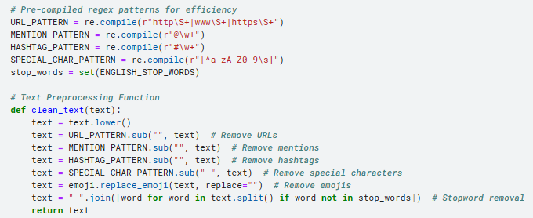
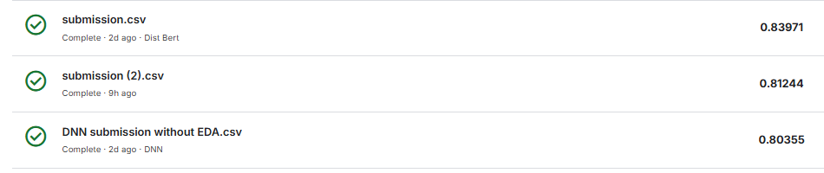
Preprocessing pitfalls
Notes:
~3.5 % in score. Why Careful Text Preprocessing is Important for BERT
BERT is designed to understand context and word relationships rather than just individual words. Unlike traditional models, it uses self-attention to analyze the entire sentence, meaning over-cleaning can remove crucial information. My generic preprocessing likely stripped away important context, such as negation words ("not," "never") and sentence structure, making it harder for BERT to differentiate disaster from non-disaster tweets. This loss of linguistic cues likely caused the lower F1 score.
Additionally, BERT tokenizes at the subword level, meaning elements like hashtags and emojis carry meaning. Removing "#flood" or an emoji like "😢" eliminates signals that help classify disasters. Instead of deleting them, they should be preserved or converted into readable tokens. This ensures BERT retains as much context as possible when processing the tweet.
Lastly, removing URLs, punctuation, and capitalization can weaken BERT’s ability to interpret text as it was trained on raw, case-sensitive data. URLs might indicate news sources or emergency alerts, and punctuation helps in sentence meaning. Over-cleaning disrupts this structure, leading to worse performance. A refined preprocessing approach—keeping negations, handling emojis correctly, and preserving key symbols—will allow BERT to make more accurate predictions.

Slide 10
Thank You
References-
DistilBERT, a distilled version of BERT: smaller, faster, cheaper and lighter https://arxiv.org/abs/1910.01108 https://arxiv.org/abs/1910.01108
Is text preprocessing still worth the time? https://www.sciencedirect.com/science/article/pii/S0306437923001783

